Slide 1

Serverless in Action

Slide 2






Who is Chad Green
chadgreen@chadgreen.com
TaleLearnCode
ChadGreen.com
ChadGreen & TaleLearnCode
ChadwickEGreen

Slide 3

Agenda
What is Serverless Computing
Functions as a Service
Serverless Options
Azure Functions Overview
Azure Functions in Action
Pricing
Best Practices

Slide 4

What is Serverless Computing

Slide 5





The evolution of application platforms
What is the right size of servers for the business needs?
How can I increase server utilization?
What happens in case of server hardware failure?
What media should I use to keep backups?
How do I deploy new code to my servers?
Who monitors my App?
How can I dynamically configure my app?
What size of servers should I buy?
Which packages should be on my server?
How often should I backup my server?

Are my servers in a secure location?
How can I scale my app?
How many servers do I need?
Do I need a secondary network connection?
Who has physical access to my servers?
How often should I patch my servers?
What storage do I need to use?
What happens if the power goes out?
Who monitors my servers?
Do I need an UPS?
It takes how long to provision a new server?
Which Operating System should I use?
On-Premises
Notes:
Get Hardware
Get and install Operating System
Get and install application framework
(No Click) Deploy code to the server
Host all of this somewhere in your datacenter
(No Click) Bunch of questions
Backup for your apps
Physical Security
Scaling Up
Monitoring (hardware and application)
And so on
Really important questions – but not key to core competency
Two clicks to get to next slide

Slide 6
The evolution of application platforms
What is the right size of servers for my business needs
How can I increase server utilization?
How many servers do I need?
How can I scale my application?

How often should I patch my servers?
How do I deploy new code to my server?
How often should I backup my server?
Which Operating Systems should I use?
Which package should be on my server?
Who monitors my application?
On-Premises
IaaS
Notes:
Infrastructure as a Service

Slide 7
The evolution of application platforms
What is the right size of servers for my business needs
How can I increase server utilization?
How many servers do I need?
How can I scale my application?

On-Premises
IaaS
PaaS
Notes:
Infrastructure as a Service

Slide 8
The evolution of application platforms






























The platform for next generation applications
On-Premises
IaaS
PaaS
Serverless
Notes:
Only Problem: How to build your app to best solve business problem?

Slide 9

What is Serverless?
Abstraction of Servers
Notes:
Abstraction of Servers
Developers can just focus on their code – there are no distractions around server management, capacity planning, or availability

Slide 10

What is Serverless?
Abstraction of Servers
Event-Driven/Instant Scale
Notes:
Event-Driven/Instant Scale
Application components react to events and triggers in near real-time with virtually unlimited scalability; compute resources are used as needed

Slide 11
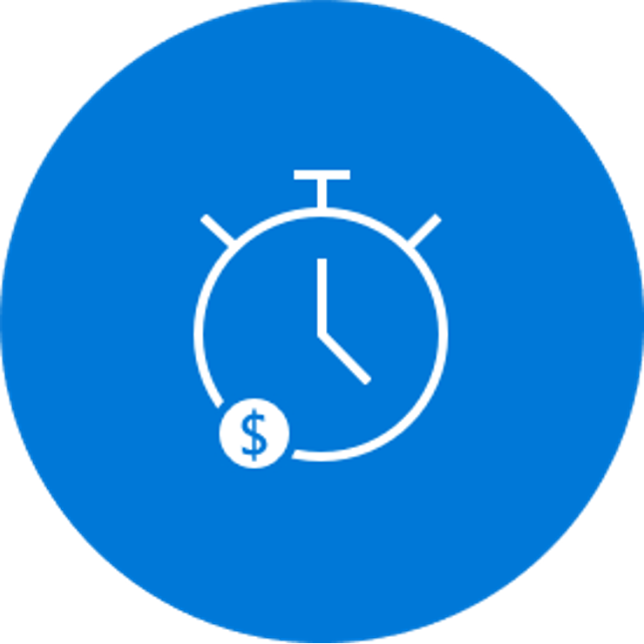
What is Serverless?
Abstraction of Servers
Event-Driven/Instant Scale
Micro-Billing
Notes:
Micro-Billing
Only pay for what you use: billing is typically calculated on the number of function calls, code execution time, and memory used

Slide 12

Benefits of Serverless
Manage apps not servers
Notes:
Complexity Managing a monolithic application as a single unit is more straightforward than managing a fleet of purpose-built functions and the dependencies between them.

Slide 13

Benefits of Serverless
Manage apps not servers
Reduced DevOps
Notes:
Organization Support
It’s a non-trivial consideration for some to move to a serverless paradigm

Slide 14
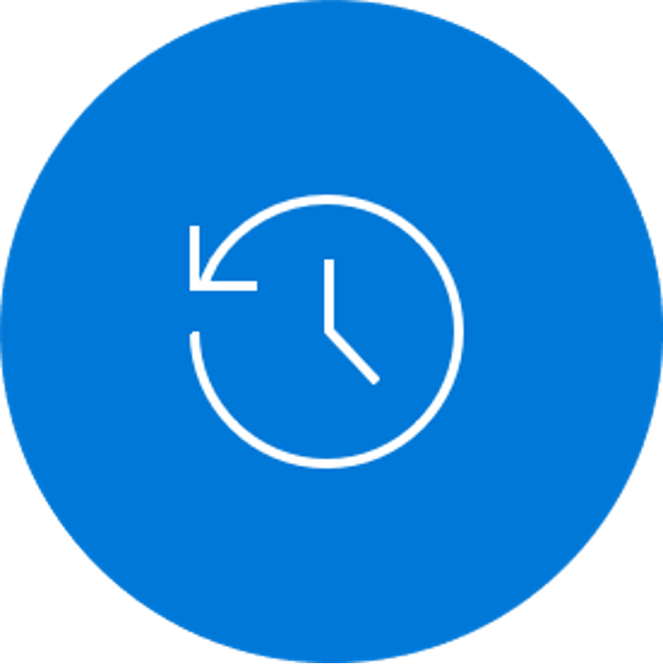
Benefits of Serverless
Manage apps not servers
Reduced DevOps
Faster Time to Market
Notes:
No Runtime Optimization
By its very nature, you mostly do not have control over the execution environment for the workload.

Slide 15
Challenges of Serverless
Complexity
Notes:
Complexity
Managing a monolithic application as a single unit is more straightforward than managing a fleet of purpose-built functions and the dependencies between them.

Slide 16
Challenges of Serverless
Complexity
Organizational Support
Notes:
Organization Support
It’s a non-trivial consideration for some to move to a serverless paradigm

Slide 17
Challenges of Serverless
Complexity
Organizational Support
No Runtime Optimization
Notes:
No Runtime Optimization
By its very nature, you mostly do not have control over the execution environment for the workload.

Slide 18
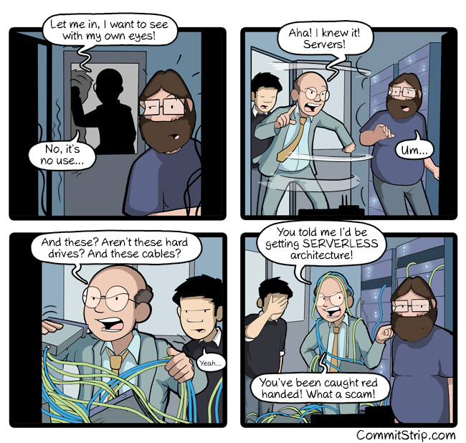
Not that isn’t servers
Just, you can think about servers less

Slide 19

Function
as a
Service

Slide 20
Flavors of Serverless
Backend as a Service (BaaS)
Applications that significantly or fully depend on services (in the cloud) to manage server-side logic and state
Notes:
Like many trends in software there is no one clear view of what ‘Serverless’ is, and that is not helped by it really coming to mean two different but overlapping areas.
Backend as a Service
Serverless was first used to describe applications that significantly or fully depended on 3rd party applications or services (“in the cloud”) to manage server-side logic and state. These are typically “rich client” applications (think single page web apps or mobile apps) that use the vast ecosystem of cloud accessible databases, authentication services, etc.

Slide 21
Flavors of Serverless
Backend as a Service (BaaS)
Functions as a Service (FaaS)
Applications that significantly or fully depend on services (in the cloud) to manage server-side logic and state
Applications run in stateless compute containers that are event-triggered ephemeral, and fully managed by a 3rd party
Notes:
Functions as a Service
Serverless can also mean applications where some amount of server-side logic is still written by the application developer but unlike traditional architectures is run in stateless compute containers that are event-triggered, ephemeral (may only last for one invocation), and fully managed by a third party.

Slide 22
Function Scale
Monolith
Microservice
Function
Function
Microservice
Function
Nano
Services
Function
Microservice
Function
Function
Microservice
Function
Notes:
Monolith
Microservices
Functions → Nano Services

Slide 23
FaaS is at center of serverless
Single Responsibility
Notes:
Single Responsibility
Functions are single-purposed, reusable pieces of code that process an input and return a result

Slide 24
FaaS is at center of serverless
Single Responsibility
Short Lived
Notes:
Short Lived
Functions don’t stick around when finished executing, freeing up resources for further executions

Slide 25
FaaS is at center of serverless
Single Responsibility
Short Lived
Stateless
Notes:
Stateless
Functions don’t hold any persistent state and don’t rely on the state of any other processes

Slide 26
FaaS is at center of serverless
Single Responsibility
Short Lived
Stateless
Event Driven
& Scalable

Slide 27

Serverless
Options

Slide 28

Market Landscape
AWS Lambda
Run code without thinking about servers. Pay only for the compute time you consume

Slide 29

Market Landscape
AWS Lambda
Google
Cloud Functions
Event-driven serverless compute platform

Slide 30


Market Landscape
AWS Lambda
Google
Cloud Functions
IBM
Cloud
Functions
Execute code on demand in a highly scalable serverless environment

Slide 31

Market Landscape
AWS Lambda
Google
Cloud Functions
IBM
Cloud
Functions
Auth0
WebTask
All you need is code

Slide 32

Market Landscape
AWS Lambda
Google
Cloud Functions
IBM
Cloud
Functions
Auth0
WebTask
Azure
Your vision. Your cloud.

Slide 33

Azure Serverless Offerings
Event Grid
Manage all events that can trigger code or logic
Notes:
Event Grid is a fully managed event routing service that enables rich application scenarios by connecting serverless logic to event coming from multiple Azure services or from your own apps.

Slide 34

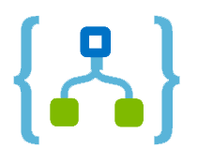
Azure Serverless Offerings
Event Grid
Logic Apps
Design workflows and orchestrate processes
Notes:
Logic Apps provides serverless workflows that allow developers to easily integrate data with their apps instead of writing complex glue code between disparate systems. Logic Apps also allow you to orchestrate and connect the serverless functions and APIs of your application.

Slide 35

Azure Serverless Offerings
Logic Apps
Functions
Event Grid
Execute your code based on events you specify
Notes:
Azure Functions is an event-driven compute experience that allows you to execute your code, written in the programming language of your choice, without worrying about servers. Benefit from scale on demand and never pay for idle capacity.
Next slide – Backend as a Service

Slide 36
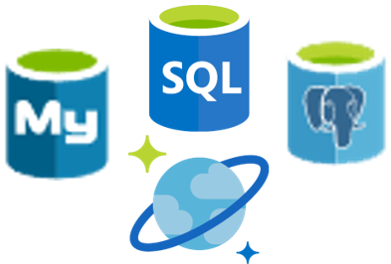
Azure Serverless Offerings
Logic Apps
Functions
Event Grid
Database
Notes:
Azure Databases deliver a database ally for your serverless app. Azure SQL, MySQL, and Progress provide industry standard database capabilities. Cosmos DB is a multi-model database service that provides transparent scaling and replication of your data to wherever your users are.

Slide 37
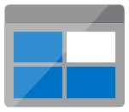
Azure Serverless Offerings
Logic Apps
Functions
Event Grid
Database
Storage
Notes:
Azure Storage provides durable, highly available, and massively scalable cloud storage to developers for cloud applications. Get options for unstructured object data, structured datasets, file storage, and queue storage for serverless communication between cloud apps.

Slide 38

Azure Serverless Offerings
Logic Apps
Functions
Event Grid
Database
Storage
Security
Notes:
Azure Active Directory provides cloud-based identity and access management. Using it, developers can securely control access to resources and manage and authenticate the users of their serverless apps.

Slide 39

Azure Serverless Offerings
Logic Apps
Functions
Event Grid
Database
Storage
Security
IoT
Notes:
IoT

Slide 40

Azure Serverless Offerings
Logic Apps
Functions
Event Grid
Database
Storage
Security
IoT
Analytics
Notes:
Azure Stream Analytics is a fully managed analytics service for real-life streaming data. It allows you to author queries in simple, declarative, SQL-like language, and you only pay for the processing used per job. Event hubs is a fully managed service that simplifies mass ingestion of small data inputs, typically from devices and sensors, to process, route, and store the data.

Slide 41

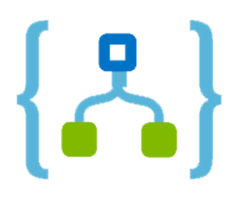

Azure Serverless Offerings
Logic Apps
Functions
Event Grid
Database
Storage
Security
IoT
Analytics
Intelligence
Notes:
Azure Bot Service allows you to build intelligent serverless bots that can interact with your users contextually through multiple channels like text/SMS, Skype, Microsoft Teams, Slack, Office 365, Twitter, and other popular services. Cognitive Services allows you to easily add intelligent features such as emotion and sentiment detection, vision, and speech recognition, language understanding, and knowledge and search – into your app. Using these services through serverless code or logic workflows minimizes the learning curve for creating intelligent apps.

Slide 42



Azure Functions
Code
Events + data

Slide 43
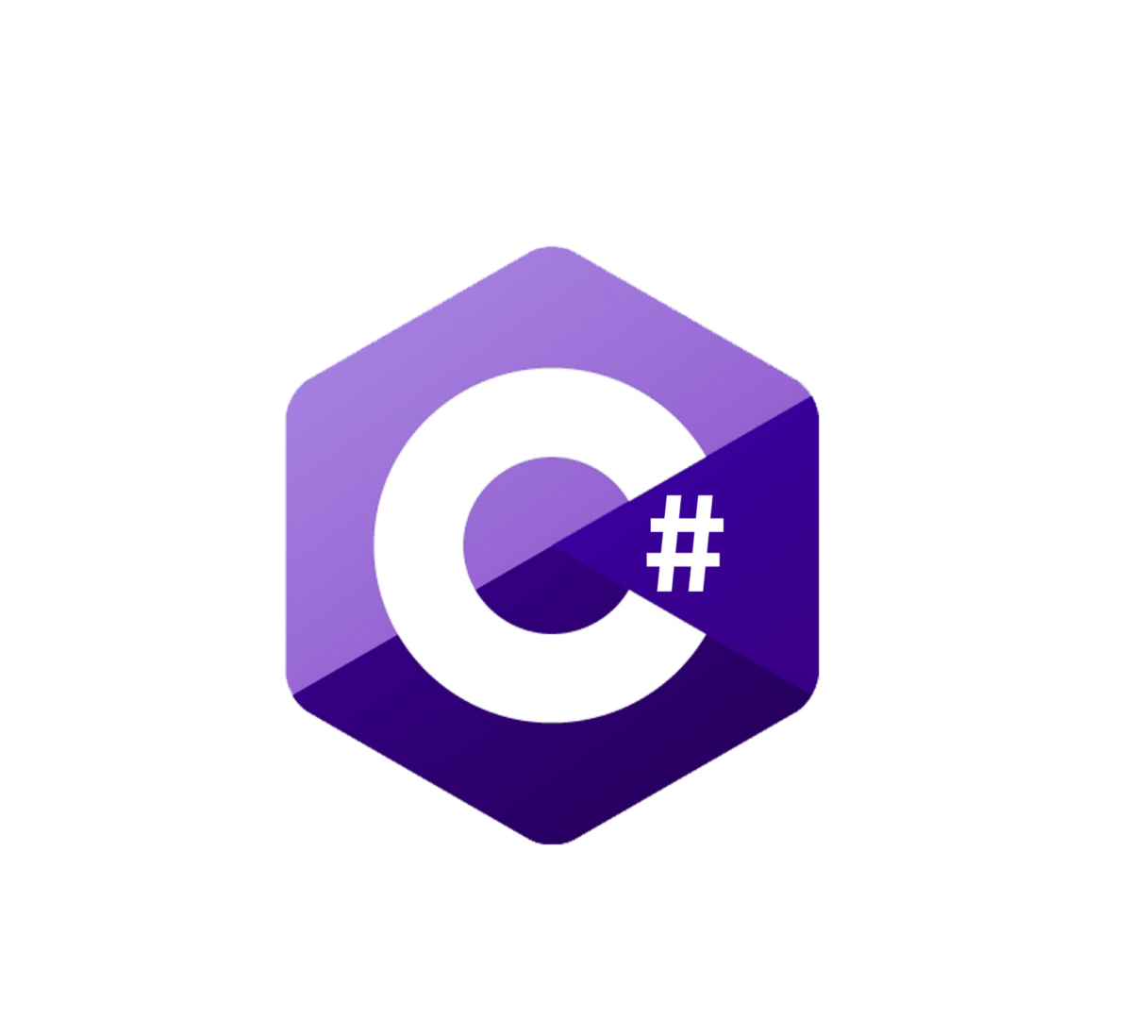






Features of Azure Function
Choice of language
Notes:
Choice of language: Azure Functions is a polyglot solution which allows you to write functions in not just C#, F#, and JavaScript, but also Java, Python, TypeScript, and even PowerShell
TypeScript supported through transpiling to JavaScript

Slide 44
Features of Azure Function
Choice of language
Language | 1.x | 2.x | 3.x | 4.x
C# | GA (.NET Framework 4.8) | GA (.NET Core 2.1) | GA (.NET Core 3.1) GA (.NET 5.0) | Preview (.NET 6)
JavaScript | GA (Node 6) | GA (Node 10 & 8) | GA (Node 14, 12, & 10) | Preview (Node 14)
F# | N/A | GA (Java 8) | GA (.NET Core 3.1) | Preview (.NET 6.0)
Java | N/A | GA (PowerShell Core 6) | GA (Java 11 & 8) | Preview (Java 11 & 8)
PowerShell | N/A | GA (Python 3.7 & 3.6) | GA (PowerShell 7.0 & Core 6) | Preview (PowerShell 7.0)
TypeScript | N/A | GA | GA | Preview

Slide 45
Features of Azure Function
Pay-per-use pricing model
Notes:
Pay-per-use pricing model: Pay for only the time spent running your code. Azure Functions consumption plan is based on per-second resource consumption and executions.

Slide 46


Features of Azure Function
Bring your own dependences
Notes:
Bring your own dependencies: Functions support both NuGet and NPM, so you can use your favorite libraries.

Slide 47
Features of Azure Function
Integrated security
Notes:
Integrated security: Protect HTTP-triggered functions with OAuth providers such as Azure Active Directory, Facebook, Google, Twitter, and Microsoft Account.

Slide 48








Features of Azure Function
Simplified Integration
Notes:
Simplified integration: Easily leverage Azure services and software-as-a-service (SaaS) offerings. These services can trigger your function and start execution or they can serve as input and output for your code.
Such services include Cosmos DB, Event Hubs, Event Grid, Mobile Apps, Notification Hubs, Service Bus, Azure Storage, GitHub, and Twilio SMS messages
Azure Services
CosmosDB
Event Hubs
Event Grid
Notifications Hub
Azure Storage (blob, queue)
3rd Party Services
RabbitMQ
GitHub
Twillio

Slide 49

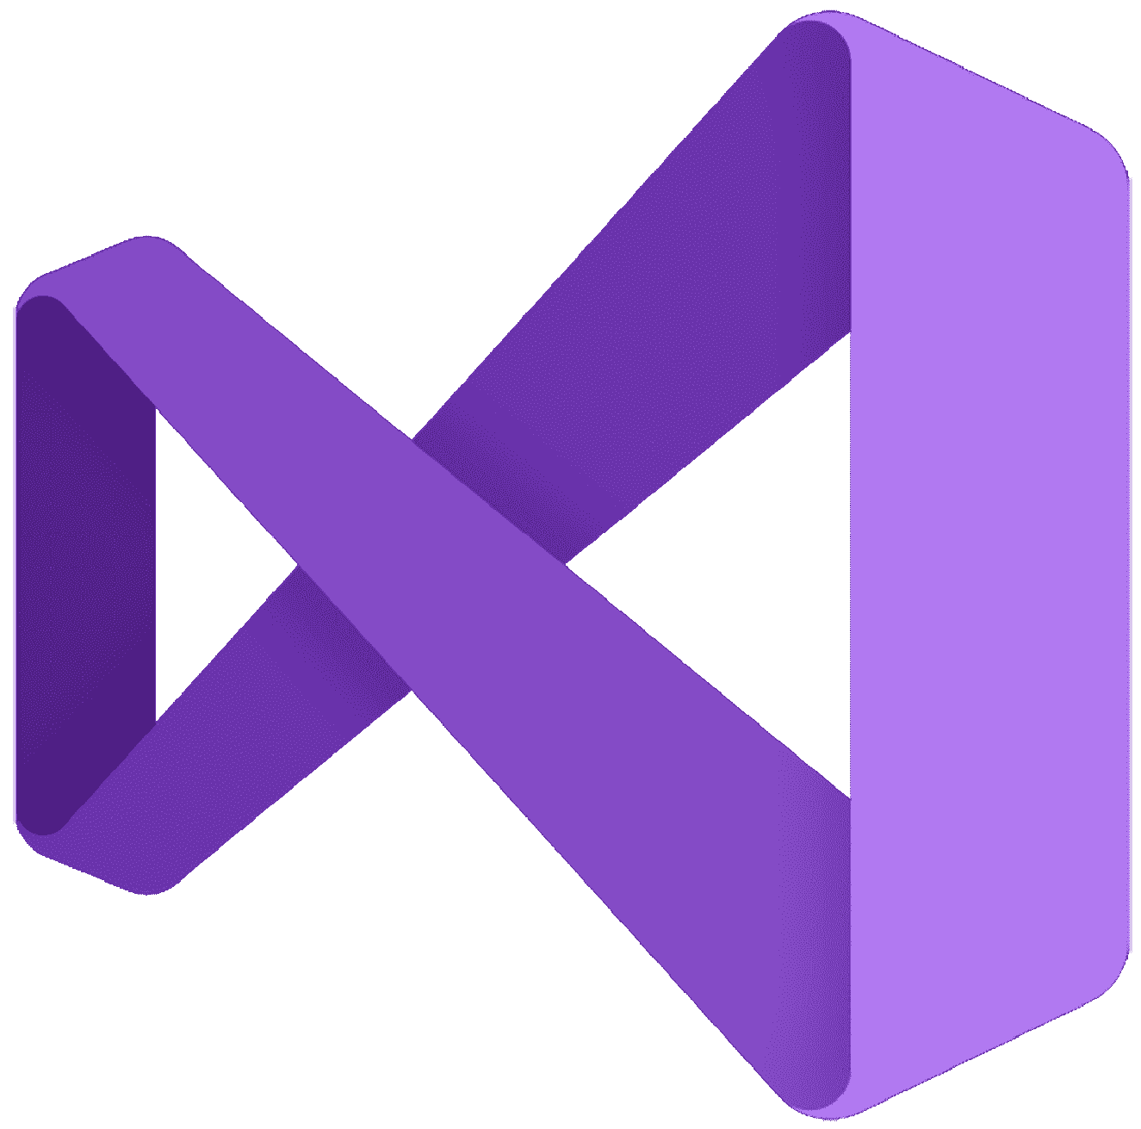

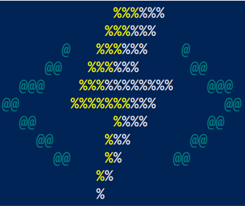

Features of Azure Function
Flexible Development
Notes:
Flexible development: Code your functions right in the portal or set up continuous integration and deploy your code through GitHub, Visual Studio Team Services, and other support development tools including OneDrive, Bitbucket, Dropbox, and either a local or external Git repository

Slide 50
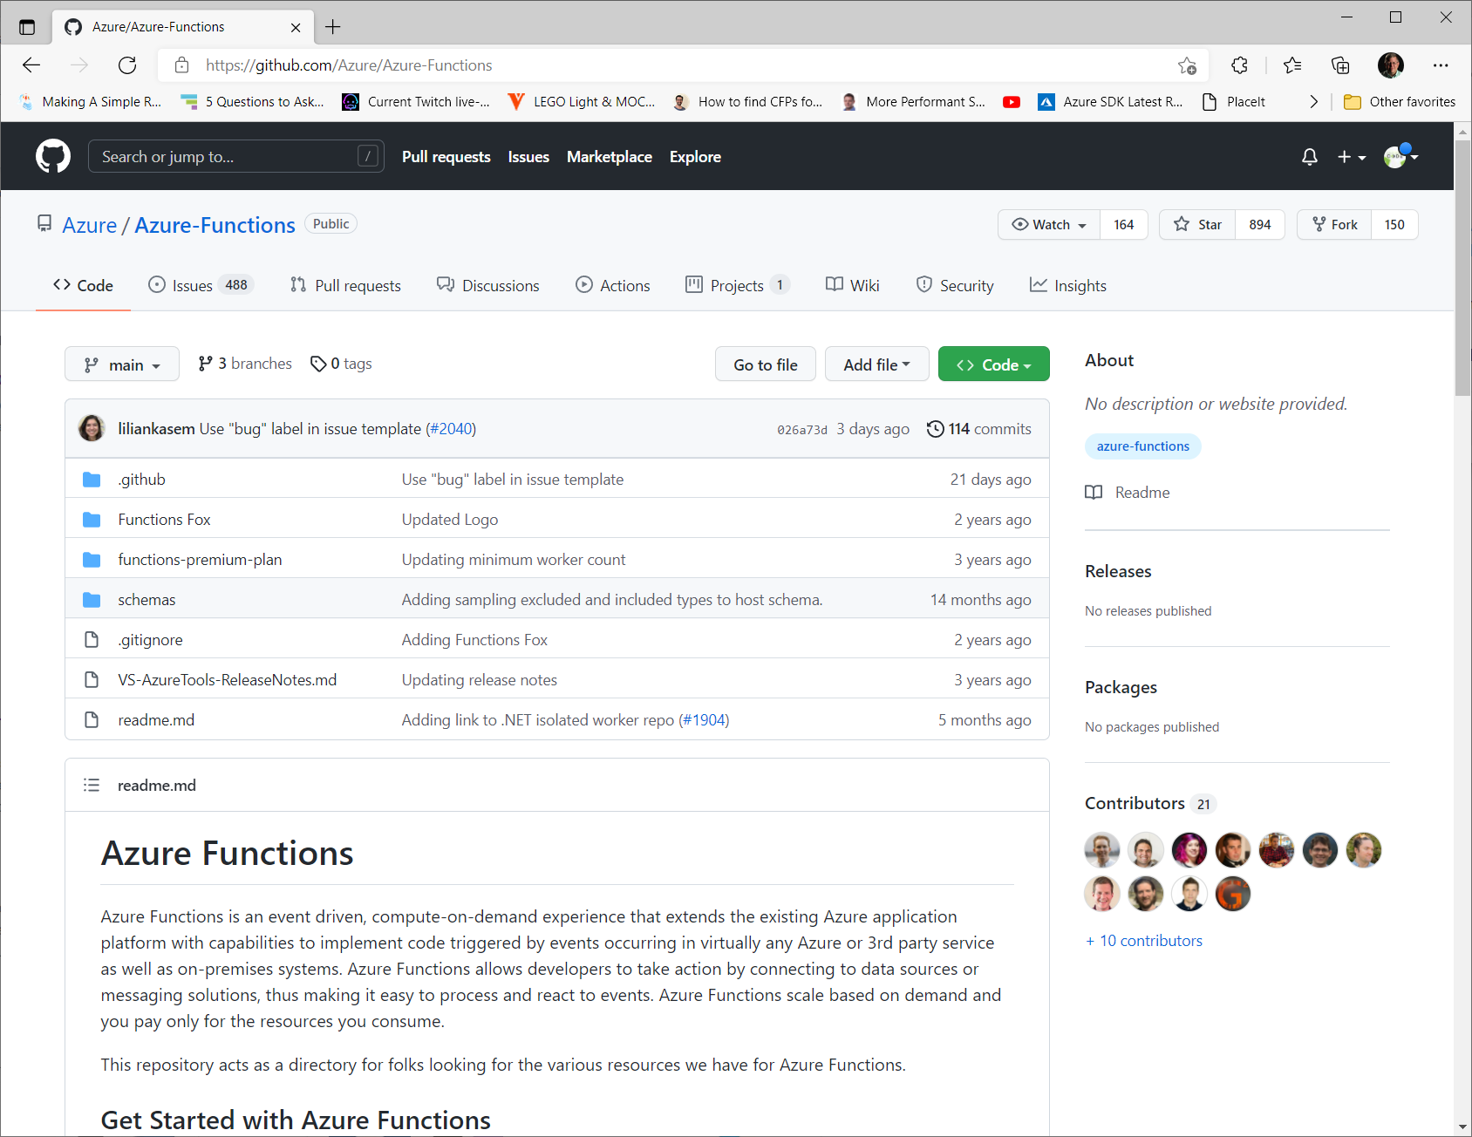
Features of Azure Function
Open-Source
Notes:
Integrated security: Protect HTTP-triggered functions with OAuth providers such as Azure Active Directory, Facebook, Google, Twitter, and Microsoft Account.

Slide 51
Triggers & Bindings
Notes:
Triggers are what cause a function to run. A trigger defines how a function is invoked and a function must have exactly one trigger. Triggers have associated date, which is often provided as the payload of the function.
Binding to a function is a way of declaratively connecting another resource to the function; bindings my be connected as input bindings, output bindings, or both. Data from bindings is provided to the function as parameters.
You can mix and match different bindings to suit your needs. Bindings are optional and a function might have one or multiple input and/or output bindings.

Slide 52
Triggers & Bindings
Blob Storage
Notes:
Blob Storage
Trigger: Runa function as blob storage data changes
Input: Read blob storage data in a function
Output: Allow a function to write blob storage data

Slide 53
Triggers & Bindings
Blob Storage

Slide 54
Triggers & Bindings
Blob Storage
Cosmos DB
Notes:
Cosmos DB
Trigger - Run a function when an Azure Cosmos DB document is created or modified
Input – Read an Azure Cosmos DB document
Output – Save changes to an Azure Cosmos DB document

Slide 55
Triggers & Bindings
Blob Storage
Cosmos DB

Slide 56
Triggers & Bindings
Blob Storage
Azure Cosmos DB
Dapr
Notes:
Dapr
Trigger, Input, Output

Slide 57
Triggers & Bindings
Blob Storage
Azure Cosmos DB
Dapr

Slide 58
Triggers & Bindings
Blob Storage
Azure Cosmos DB
Dapr
Event Grid
Notes:
Event Grid
Trigger – Run a function when an Event Grid event is dispatched
Output – Send an event Grid event

Slide 59
Triggers & Bindings
Blob Storage
Azure Cosmos DB
Dapr
Event Grid

Slide 60
Triggers & Bindings
Blob Storage
Azure Cosmos DB
Dapr
Event Grid
Event Hubs
Notes:
Event Hubs
Trigger – Respond to events sent to an event hub event stream
Output – Write events to an event stream

Slide 61
Triggers & Bindings
Blob Storage
Azure Cosmos DB
Dapr
Event Grid
Event Hubs

Slide 62
Triggers & Bindings
Blob Storage
Azure Cosmos DB
Dapr
Event Grid
HTTP
Event Hubs
Notes:
HTTP
Trigger – Run a function from an HTTP request
Output – Return an Http response from a function

Slide 63
Triggers & Bindings
Blob Storage
Azure Cosmos DB
Dapr
Event Grid
HTTP
Event Hubs

Slide 64
Triggers & Bindings
Blob Storage
Azure Cosmos DB
Dapr
Event Grid
IoT Hub
Event Hubs
HTTP
Notes:
IoT Hub
Trigger – Respond to event sent to an IoT hub event stream
Output – Write events to an IoT event stream

Slide 65
Triggers & Bindings
Blob Storage
Azure Cosmos DB
Dapr
Event Grid
IoT Hub
Event Hubs
HTTP

Slide 66
Triggers & Bindings
Blob Storage
Azure Cosmos DB
Dapr
Event Grid
Kafka
Event Hubs
HTTP
IoT Hub
Notes:
Kafka
Trigger, Output

Slide 67
Triggers & Bindings
Blob Storage
Azure Cosmos DB
Dapr
Event Grid
Kafka
Event Hubs
HTTP
IoT Hub

Slide 68
Triggers & Bindings
Blob Storage
Azure Cosmos DB
Dapr
Event Grid
Queue Storage
Event Hubs
HTTP
IoT Hub
Kafka
Notes:
Queue Storage
Trigger – Run a function as queue storage data changes
Output – Write queue storage messages

Slide 69
Triggers & Bindings
Blob Storage
Azure Cosmos DB
Dapr
Event Grid
Queue Storage
Event Hubs
HTTP
IoT Hub
Kafka

Slide 70
Triggers & Bindings
Blob Storage
Azure Cosmos DB
Dapr
Event Grid
RabbitMQ
Event Hubs
HTTP
IoT Hub
Kafka
Queue Storage
Notes:
RabbitMQ
Trigger – Run a function when a RabbitMQ message comes through the queue
Output – Send RabbitMQ messages

Slide 71
Triggers & Bindings
Blob Storage
Azure Cosmos DB
Dapr
Event Grid
RabbitMQ
Event Hubs
HTTP
IoT Hub
Kafka
Queue Storage

Slide 72
Triggers & Bindings
Blob Storage
Azure Cosmos DB
Dapr
Event Grid
SendGrid
Event Hubs
HTTP
IoT Hub
Kafka
Queue Storage
RabbitMQ
Notes:
SendGrid
Ouput – Send email

Slide 73
Triggers & Bindings
Blob Storage
Azure Cosmos DB
Dapr
Event Grid
SendGrid
Event Hubs
HTTP
IoT Hub
Kafka
Queue Storage
RabbitMQ

Slide 74
Triggers & Bindings
Blob Storage
Azure Cosmos DB
Dapr
Event Grid
Service Bus
Event Hubs
HTTP
IoT Hub
Kafka
Queue Storage
RabbitMQ
SendGrid
Notes:
Service Bus
Trigger – Run a function when a Service Bus queue or topic message is created
Output – Send Azure Service Bus messages

Slide 75
Triggers & Bindings
Blob Storage
Azure Cosmos DB
Dapr
Event Grid
Service Bus
Event Hubs
HTTP
IoT Hub
Kafka
Queue Storage
RabbitMQ
SendGrid

Slide 76
Triggers & Bindings
Blob Storage
Azure Cosmos DB
Dapr
Event Grid
SignalR
Event Hubs
HTTP
IoT Hub
Kafka
Queue Storage
RabbitMQ
SendGrid
Service Bus
Notes:
SignalR
Input – Return the service endpoint URL and access token
Ouptut – Send SinglR Service messages

Slide 77
Triggers & Bindings
Blob Storage
Azure Cosmos DB
Dapr
Event Grid
SignalR
Event Hubs
HTTP
IoT Hub
Kafka
Queue Storage
RabbitMQ
SendGrid
Service Bus

Slide 78
Triggers & Bindings
Blob Storage
Azure Cosmos DB
Dapr
Event Grid
Table Storage
Event Hubs
HTTP
IoT Hub
Kafka
Queue Storage
RabbitMQ
SendGrid
Service Bus
SignalR
Notes:
Table Storage
Input – Read table storage data in a function
Output – Allow a function to write table storage data

Slide 79
Triggers & Bindings
Blob Storage
Azure Cosmos DB
Dapr
Event Grid
Table Storage
Event Hubs
HTTP
IoT Hub
Kafka
Queue Storage
RabbitMQ
SendGrid
Service Bus
SignalR

Slide 80
Triggers & Bindings
Blob Storage
Azure Cosmos DB
Dapr
Event Grid
Timer
Event Hubs
HTTP
IoT Hub
Kafka
Queue Storage
RabbitMQ
SendGrid
Service Bus
SignalR
Table Storage
Notes:
Timer
Trigger

Slide 81
Triggers & Bindings
Blob Storage
Azure Cosmos DB
Dapr
Event Grid
Timer
Event Hubs
HTTP
IoT Hub
Kafka
Queue Storage
RabbitMQ
SendGrid
Service Bus
SignalR
Table Storage

Slide 82
Triggers & Bindings
Blob Storage
Azure Cosmos DB
Dapr
Event Grid
Twilio
Event Hubs
HTTP
IoT Hub
Kafka
Queue Storage
RabbitMQ
SendGrid
Service Bus
SignalR
Table Storage
Timmer
Notes:
Twilio
Output

Slide 83
Triggers & Bindings
Blob Storage
Azure Cosmos DB
Dapr
Event Grid
Twilio
Event Hubs
HTTP
IoT Hub
Kafka
Queue Storage
RabbitMQ
SendGrid
Service Bus
SignalR
Table Storage
Timmer

Slide 84
Triggers & Bindings
Blob Storage
Azure Cosmos DB
Dapr
Event Grid
Event Hubs
HTTP
IoT Hub
Kafka
Queue Storage
RabbitMQ
SendGrid
Service Bus
SignalR
Table Storage
Timmer
Twilio

Slide 85
Runtime Versions
1.x
Notes:
Recommended only for C# apps that must use .NET Framework

Slide 86
Runtime Versions
1.x

Slide 87
Runtime Versions
2.x
1.x
Notes:
Supported for legacy version 2.x apps – maintenance mode

Slide 88
Runtime Versions
2.x
1.x
Notes:
Recommended only for C# apps that must use .NET Framework

Slide 89
Runtime Versions
3.x
1.x
2.x
Notes:
Recommended runtime version for functions in all languages

Slide 90
Runtime Versions
3.x
1.x
2.x

Slide 91
Runtime Versions
4.x
1.x
2.x
3.x
Notes:
Supports all languages. Use this version to run C# functions on .NET 6.0

Slide 92
Runtime Versions
4.x
1.x
2.x
3.x

Slide 93
Runtime Versions
1.x
2.x
3.x
4.x

Slide 94
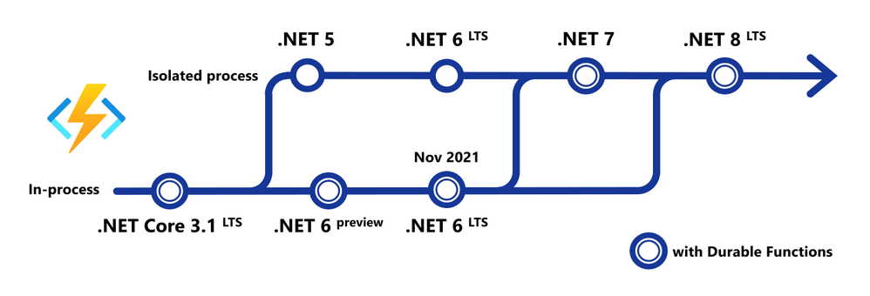
Runtime Versions
1.x
2.x
3.x
4.x

Slide 95
Ways to Run Functions
Consumption
Serverless
Notes:
Consumption
Serverless
Pay only for what you use! Metering is per execution and per Gb second.

Slide 96

Ways to Run Functions
Consumption
App Service
Plan
Always On
Notes:
App Service Plan
Free, Basic, Standard, Premium
All the advantages of Functions with the SLA and “always on” feature of an App Service Plan

Slide 97
Ways to Run Functions
Consumption
App Service
Plan
App Service
Environment
Network Isolation
Notes:
App Service Environment
Network Isolation
Your own dedicated cloud environment with network isolation for apps, higher scale, and the ability to connect the ability to connect securely to local vNets.

Slide 98

Ways to Run Functions
Consumption
App Service
Plan
App Service
Environment
Azure
Stack
On Premises
Notes:
Azure Stack
On Premises
Leverage cloud innovations in on-premises infrastructure. Azure Stack brings the power of Azure to your data centers.

Slide 99
Ways to Run Functions
Consumption
App Service
Plan
Azure
Stack
Azure
Functions
Runtime
App Service
Environment
Functions on Your Server
Notes:
Azure Functions Runtime
Functions on your Server
Run your Azure Function on your local server (without the rest of Azure)

Slide 100

Ways to Run Functions
Consumption
App Service
Plan
Azure
Stack
Azure
Functions
Runtime
Azure
IoT
Edge
App Service
Environment
On Devices
Notes:
Azure IoT Edge
On Devices
Run on IoT Devices by deploying custom modules

Slide 101

Demos
Notes:
So let’s put all the pieces together and go through some demos

Slide 102
Demos

Slide 103

Best Practices

Slide 104
Absolute Minimum Best Practices
Should do one thing

Slide 105
Absolute Minimum Best Practices
Should be idempotent
Notes:
Idempotent – Clients can make the same call repeatedly while producing the same result. In other words, making multiple identical requests has the same effect as making a single request. Note that while idempotent operations produce the same result on the server (no side effects), the response itself may not be the same – a source’s state may change between requests.

Slide 106
Absolute Minimum Best Practices
Should finish as quickly as possible

Slide 107
Function Timeouts
Default Timeout of 5 Minutes
Notes:
Consumption Plan is restricted to 5 minutes by default with a maximum timeout of 10 minutes

Slide 108
Function Timeouts
Use App Service or Durable Functions for Longer Running Functions
Notes:
Durable Functions is an extension of Azure Functions and Azure WebJobs that lets you write stateful functions in a serverless environment. The extension manages state, checkpoints, and restarts for you.

Slide 109
General Best Practices
Avoid long running functions
Notes:
Large, long-running functions can cause unexpected timeout issues. A function can become large due to many Node.js dependencies. Importing dependencies can also cause increased load times that results in unexpected timeouts. Dependencies are loaded both explicitly and implicitly. A single module loaded by your code may load its own additional modules.
Whenever possible, refactor large functions into smaller function sets that work together and return responses fast. For example, a webhook or HTTP trigger might require an acknowledgment response within a certain time limit; it is common for webhooks to require an immediate response. You can pass the HTTP trigger payload into a queue to be processed by a queue trigger function. This approach allows you to defer the actual work and turn an immediate response.

Slide 110
General Best Practices
Avoid cross function communication
Notes:
Large, long-running functions can cause unexpected timeout issues. A function can become large due to many Node.js dependencies. Importing dependencies can also cause increased load times that results in unexpected timeouts. Dependencies are loaded both explicitly and implicitly. A single module loaded by your code may load its own additional modules.
Whenever possible, refactor large functions into smaller function sets that work together and return responses fast. For example, a webhook or HTTP trigger might require an acknowledgment response within a certain time limit; it is common for webhooks to require an immediate response. You can pass the HTTP trigger payload into a queue to be processed by a queue trigger function. This approach allows you to defer the actual work and turn an immediate response.

Slide 111
General Best Practices
Write functions to be stateless
Notes:
Functions should be stateless and idempotent if possible. Associate any required state information with your data. For example, an order being processed would likely have an associated state member. A function could process an order based on that state while the function itself remains stateless.
Idempotent functions are especially recommended with timer triggers. For example, if you have something that absolutely must run once a day, write it so it can run any time during the day with the same results. The function can exit when there is no work for a particular day. Also if a previous run failed to complete, the next run should pick up where it left off.

Slide 112
General Best Practices
Write defensive functions
Notes:
Assume your function could encounter an exception at any time. Design your functions with the ability to continue from a previous fail point during the next execution. Consider a scenario that requires the following actions:
Query for 10,000 rows in a database.
Create a queue message for each of those rows to process further down the line.
Depending on how complex your system is, you may have: involved downstream services behaving badly, network outages, or quota limits reached, etc. All of these can affect your function at any time, You need to design your functions to be prepared for it.
How does your code react if a failure occurs after inserting 5,000 of those items into a queue for processing? Track items in a set that you have completed. Otherwise, you might insert them again next time. This can have a serious impact on your workflow.
If a queue item has already processed, allow your function to be a no-op.

Slide 113
Scalability Best Practices
Do not mix test and production
Notes:
Do not mix test and production code in the same function app
There are a number of factors which impact how instances of your function app scale. The following are some best practices to ensure optimal scalability of a function app.
Functions within a function app share resource. For example, memory is shared. If you are using a function app in production, do not add test-related functions and resource to it. It can cause unexpected overhead during production code execution.
Be careful of what you load in your production function apps. Memory is averaged across each function in the app.
Do not use verbose logging in production code – it has a negative performance impact.

Slide 114
Scalability Best Practices
Use async code but avoid blocking calls
Notes:
Use async code but avoid blocking calls
Asynchronous programming is a recommended best practice. However, always avoid referencing the Result property or calling the Wait method on a Task instance. This approach can lead to thread exhaustion.

Slide 115
Scalability Best Practices
Receive messages in batch
Notes:
Receive messages in batch whenever possible
Some triggers like Event Hub enable receiving a batch of messages on a single invocation. Batching messages has much better performance.

Slide 116
Scalability Best Practices
Receive messages in batch
Notes:
Receive messages in batch whenever possible
Some triggers like Event Hub enable receiving a batch of messages on a single invocation. Batching messages has much better performance.

Slide 117
How to get Started
Start small
Integration is a great way to start
Notes:
How to get started
Start small, replace 1 API or background processing item
Integration is a great place, often it’s a new layer on top of old layers.

Slide 118
Who is Chad Green
chadgreen@chadgreen.com
TaleLearnCode
ChadGreen.com
ChadGreen & TaleLearnCode
ChadwickEGreen

